Slide 1
Chapter 12
Distributed Database Management Systems

Slide 2
Learning Objectives
After completing this chapter, you will be able to:
Explain the purpose and function of distributed database management systems (DDBMSs)
Summarize the advantages and disadvantages of DDBMSs
Describe the characteristics and components of DDBMSs
Explain how database implementation is affected by different levels of data and process distribution
Understand how transactions are managed in a distributed database environment
Describe how distributed database design balances performance, scalability, and availability
Explain the trade-offs of implementing a distributed data system

Slide 3
The Evolution of Distributed Database Management Systems (1 of 5)
A distributed database management system (DDBMS)
Governs storage and processing of logically related data over interconnected computer systems
Distributes data and processing functions among several sites
Centralized database management system
Required corporate data be stored in a single central site
Provided data access through dumb terminals
Filled structured information needs of corporations; fell short when quickly moving events required faster response times and equally quick access to information

Slide 4
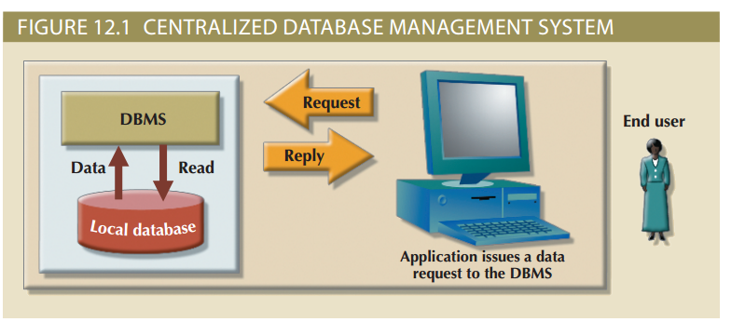
The Evolution of Distributed Database Management Systems (2 of 5)

Slide 5
The Evolution of Distributed Database Management Systems (3 of 5)
Changes that affected the nature of systems
Globalization of business operation
Increased market needs for an on-demand transaction style, based on web-based services
Rapid social and technological changes fueled by low-cost smart mobile devices
Converging data realms in the digital world
Advent of social media to reach new customers and markets

Slide 6
The Evolution of Distributed Database Management Systems (4 of 5)
Database requirements in a dynamic business environment
Rapid ad hoc data access
Crucial in the quick-response decision-making environment
Distributed data access
Needed to support geographically dispersed business units

Slide 7
The Evolution of Distributed Database Management Systems (5 of 5)
Factors that influenced DDBMS
Acceptance of Internet as a platform for business
Mobile wireless revolution
Growth of use of “application as a service”
Focus on mobile business intelligence
Emphasis on Big Data analytics
Potential centralized DBMS problems
Performance degradation
High costs
Reliability problems
Scalability problems
Organizational rigidity

Slide 8
DDBMS Advantages and Disadvantages
Table 12.1: Distributed DBMS Advantages and Disadvantages
Advantages | Disadvantages
Data is located near the site of greatest demand. The data in a distributed database system is dispersed to match business requirements. | Complexity of management and control. Applications must recognize data location and be able to stitch together data from various sites. Database administrators must have the ability to coordinate database activities to prevent database degradation due to data anomalies.
Faster data access. End users often work with only the nearest stored subset of the data. | Technological difficulty. Data integrity, transaction management, concurrency control, security, backup, recovery, and query optimization must all be addressed and resolved.
Faster data processing. A distributed database system spreads out the system’s workload by processing data at several sites. | Security. Probability of security lapses increases when data is located at multiple sites. Responsibility of data management will be shared by different people at several sites.
Growth facilitation. New sites can be added to the network without affecting the operations of other sites. | Lack of standards. No standard communication protocols at the database level. Different database vendors employ different and often incompatible techniques to manage the distribution of data and processing in a DDBMS environment.
Improved communications. Because local sites are smaller and located closer to customers, local sites foster better communication among departments and between customers and company staff. | Increased storage and infrastructure requirements. Multiple copies of data are required at different sites, thus requiring additional storage space.
Reduced operating costs. It’s more cost-effective to add nodes to a network than to update a mainframe system. Development work is done more cheaply and quickly on low-cost PCs and laptops than on mainframes. | Increased training cost. Training costs are generally higher in a distributed model than they would be in a centralized model, sometimes even to the extent of offsetting operational and hardware savings.
User-friendly interface. Client devices are usually equipped with an easy-to-use graphical user interface (GUI). The G UI simplifies training and use for end users. | Higher costs. Distributed databases require duplicated infrastructure to operate, such as physical location, environment, personnel, software, and licensing.
Less danger of a single-point failure. When one of the computers fails, the workload is picked up by other workstations. Data is also distributed at multiple sites.
Processor independence. The end user can access any available copy of the data, and an end user’s request is processed by any processor at the data location.

Slide 9
Distributed Processing and Distributed Databases (1 of 3)
Distributed processing: database’s logical processing is shared among two or more physically independent sites via network
Distributed database: stores logically related database over two or more physically independent sites via a computer network
Database fragments: database composed of many parts in distributed database system

Slide 10
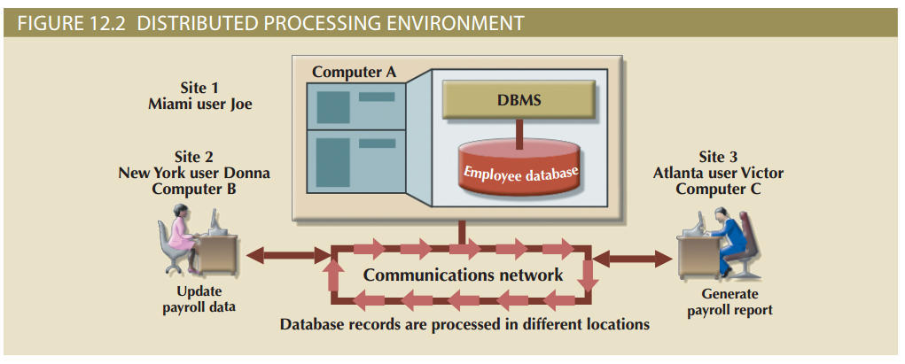
Distributed Processing and Distributed Databases (2 of 3)

Slide 11
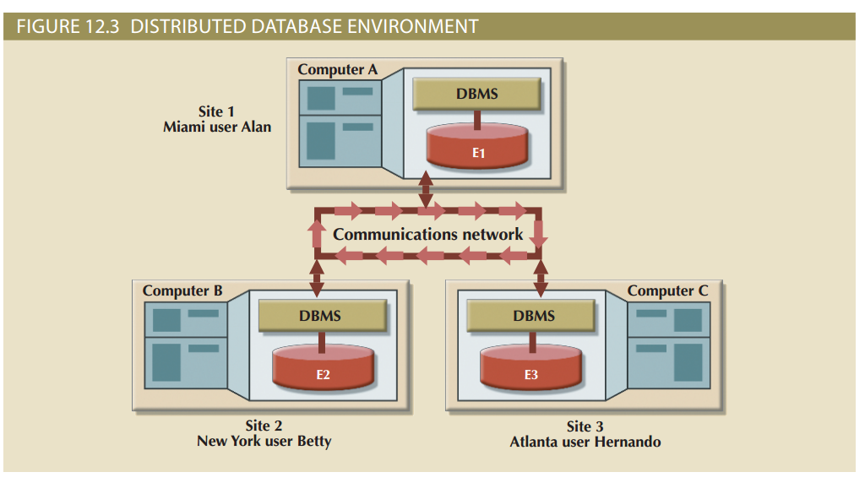
Distributed Processing and Distributed Databases (3 of 3)

Slide 12
Characteristics of Distributed Management Systems (1 of 3)
A DBMS must have several functions to be classified as distributed
Application interface
Validation
Transformation
Query optimization
Mapping
I/O interface
Formatting
Security
Backup and recovery
DB administration
Concurrency control
Transaction management

Slide 13
Characteristics of Distributed Management Systems (2 of 3)
Functions of fully distributed DBMS
Receive the request of an application or end user
Validate, analyze, and decompose the request
Map request’s logical-to-physical data components
Decompose request into several I/O operations
Search, locate, read and validate data
Ensure database consistency, security, and integrity
Validate data for conditions specified by request
Present data in required format
Handle all necessary functions transparently to user

Slide 14
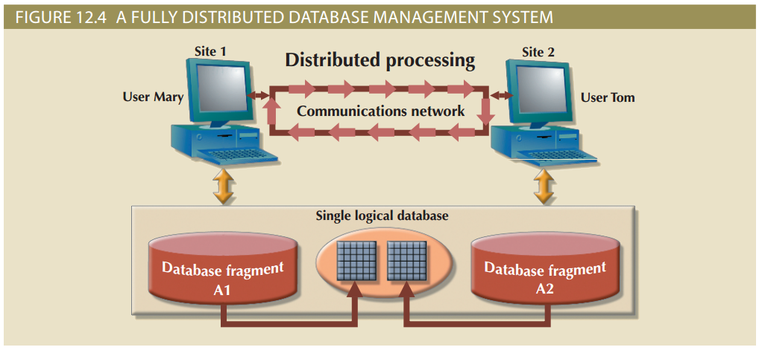
Characteristics of Distributed Management Systems (3 of 3)

Slide 15
DDBMS Components
The DDBMS must include at least the following components:
Computer workstations or remote devices
Network hardware and software components
Communications media
Transaction processor (TP)
Data processor (DP) or data manager (DM)

Slide 16
Levels of Data and Process Distribution
Table 12.2 Database Systems: Levels of Data and Process Distribution
Advantages | Single-Site Data | Multiple-Site Data
Single-site process | Host DBMS | Not applicable (Requires multiple processes)
Multiple-site process | File server Client/server DBMS (LAN DBMS) | Fully distributed Client/server DDBMS

Slide 17
Single-Site Processing, Single-Site Data (SPSD) (1 of 2)
Characteristics
Processing is done on a single host computer
Data stored on host computer’s local disk
Processing cannot be done on end user’s side
DBMS is accessed by connected terminals

Slide 18
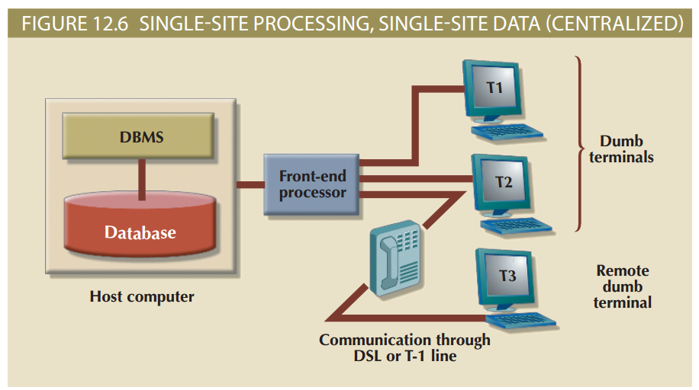
Single-Site Processing, Single-Site Data (SPSD) (2 of 2)

Slide 19
Multiple-Site Processing, Single-Site Data (MPSD) (1 of 2)
Multiple processes run on different computers sharing a single data repository
Typically requires network file server running conventional applications
Accessed through LAN
Client/server architecture
Reduces network traffic
Distributes processing
Supports data at multiple sites

Slide 20
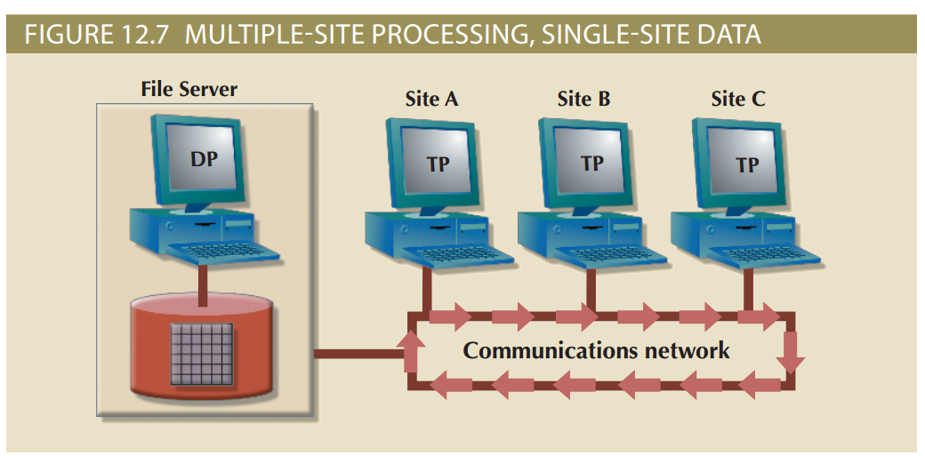
Multiple-Site Processing, Single-Site Data (MPSD) (2 of 2)

Slide 21
Multiple-Site Processing, Multiple-Site Data (MPMD) (1 of 2)
Fully distributed database management system
Support multiple data processors and transaction processors at multiple sites
Classifications
Homogeneous: integrate multiple instances of same DBMS over a network
Heterogeneous: integrate different types of DBMSs over a network
Fully heterogeneous: support different DBMSs, each supporting different data model running under different computer systems

Slide 22
Multiple-Site Processing, Multiple-Site Data (MPMD) (2 of 2)
Restrictions of DDBMS
Remote access is provided on a read-only basis
Restrictions on the number of remote tables that may be accessed in a single transaction
Restrictions on the number of distinct databases that may be accessed
Restrictions on the database model that may be accessed

Slide 23
Distributed Database Transparency Features
Minimum desirable DDBMS transparency features
Distribution transparency
Transaction transparency
Failure transparency
Performance transparency
Heterogeneity transparency

Slide 24
Distribution Transparency
Allows management of physically dispersed database as if centralized
Levels: fragmentation, location, and local mapping
Unique fragment: each row is unique, regardless of the fragment in which it is located
Supported by distributed data dictionary (DDD) or distributed data catalog (DDC)
DDC contains the description of the entire database as seen by the database administrator
Distributed global schema: common database schema to translate user requests into subqueries

Slide 25
Transaction Transparency
Transaction transparency: DDBMS property that ensures database transactions will maintain the distributed database’s integrity and consistency
Ensures transaction completed only when all database sites involved complete their part
Distributed database systems require complex mechanisms to manage transactions
Ensure the database’s consistency and integrity

Slide 26
Distributed Requests and Distributed Transactions
Remote request
Single SQL statement accesses data processed by a single remote database processor
Remote transaction
Accesses data at single remote site composed of several requests
Distributed transaction
Requests data from several different remote sites on network
Distributed request
Single SQL statement references data at several DP sites

Slide 27
Distributed Concurrency Control (1 of 2)
Concurrency control is especially important in distributed databases environment
Multi-site, multiple-process operations are more likely to create inconsistencies and deadlocked transactions
Solution to inconsistent database is a two-phase commit protocol

Slide 28
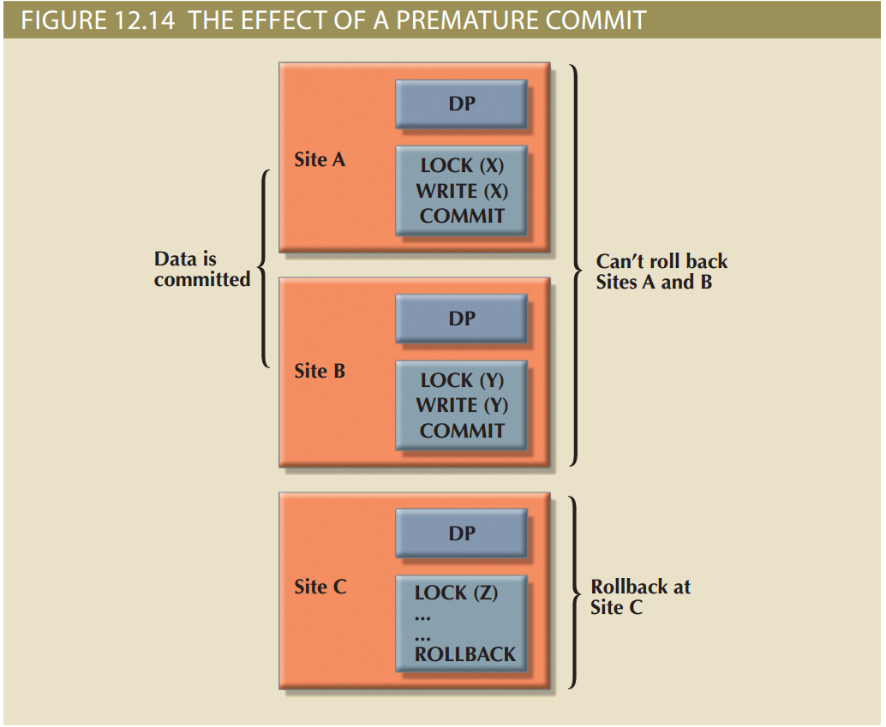
Distributed Concurrency Control (2 of 2)

Slide 29
Two-Phase Commit Protocol (2PC)
Guarantees if a portion of a transaction operation cannot be committed, all changes made at the other sites will be undone
Maintains a consistent database state
Requires each DP’s transaction log entry be written before database fragment is updated
DO-UNDO-REDO protocol: roll transactions back and forward with the help of the system’s transaction log entries
Write-ahead protocol: forces the log entry to be written to permanent storage before actual operation takes place
Two-phase commit protocol defines operations between coordinator and subordinates
Phases of implementation
Preparation
Final COMMIT

Slide 30
Performance and Failure Transparency (1 of 2)
Performance transparency allows a DDBMS to perform as if it were a centralized database
Failure transparency ensures the system will operate in case of network failure
Objective of query optimization is to minimize total costs
Access time (I/O) cost involved in accessing data from multiple remote sites
Communication costs associated with data transmission
CPU time cost associated with the processing overhead

Slide 31
Performance and Failure Transparency (2 of 2)
Considerations for resolving data requests in a distributed data environment
Data distribution and data replication
Replica transparency: DDBMS’s ability to hide multiple copies of data from the user
Network and node availability
Network latency: delay imposed by the amount of time required for a data packet to make a round trip
Network partitioning: delay imposed when nodes become suddenly unavailable due to a network failure

Slide 32
Distributed Database Design
Data fragmentation
How to partition database into fragments
Data replication
Which fragments to replicate
Data allocation
Where to locate those fragments and replicas

Slide 33
Data Fragmentation
Breaks a single object into two or more segments
Information is stored in distributed data catalog (DDC)
Strategies
Horizontal fragmentation: division of a relation into subsets (fragments) of tuples (rows)
Vertical fragmentation: division of a relation into attribute (column) subsets
Mixed fragmentation: combination of horizontal and vertical strategies

Slide 34
Data Replication (1 of 2)
Storage of data copies at multiple sites served by a computer network
Mutual consistency rule requires all copies of data fragments be identical
Styles of replication
Push replication focuses on maintaining data consistency
Pull replication focuses on maintaining data availability and allows for temporary data inconsistencies

Slide 35
Data Replication (2 of 2)
Data replication scenarios
Fully replicated database: stores multiple copies of each database fragment at multiple sites
Partially replicated database: stores multiple copies of some database fragments at multiple sites
Unreplicated database: stores each database fragment at a single site

Slide 36
Data Allocation
Data allocation strategies
Centralized data allocation: entire database stored at one site
Partitioned data allocation: database is divided into two or more disjoined fragments and stored at two or more sites
Replicated data allocation: copies of one or more database fragments are stored at several sites

Slide 37
The CAP Theorem (1 of 2)
CAP stands for:
Consistency
Availability
Partition tolerance
Trade-off between consistency and availability generated in a new system in which data is basically available, soft state, eventually consistent (BASE)
Data changes are not immediate but propagate slowly through the system until all replicas are consistent

Slide 38
The CAP Theorem (2 of 2)
Table 12.8 Distributed Database Spectrum
DBMS Type | Consistency | Availability | Partition Tolerance | Transaction Model | Trade-Off
Centralized DBMS | High | High | N/A | ACID | No distributed data processing
Relational DBMS | High | Relaxed | High | ACID (2PC) | Sacrifices availability to ensure consistency and isolation
NoSQL DDBMS | Relaxed | High | High | BASE | Sacrifices consistency to ensure availability
NewSQL DDBMS | High | High | Relaxed | ACID | Sacrifices partition tolerance to ensure transaction consistency and availability

Slide 39
C. J. Date’s 12 Commandments for Distributed Databases
Table 12.9 | C. J. Date ’s 12 Commandments for Distributed Databases
Rule Number | Rule Name | Rule Explanation
1 | Local-site independence | Each local site can act as an independent, autonomous, centralized DBMS. Each site is responsible for security, concurrency control, backup, and recovery.
2 | Central-site independence | Each local site can act as an independent, autonomous, centralized DBMS. Each site is responsible for security, concurrency control, backup, and recovery.
3 | Failure independence | The system is not affected by node failures. The system is in continuous operation even in the case of a node failure or an expansion of the network.
4 | Failure Independence | The user does not need to know the location of data to retrieve that data.
5 | Fragmentation transparency | Data fragmentation is transparent to the user, who sees only one logical database. The user does not need to know the name of the database fragments to retrieve them.
6 | Replication transparency | The user sees only one logical database. The DDBMS transparently selects the database fragment to access. To the user, the DDBMS manages all fragments transparently.
7 | Distributed query processing | A distributed query may be executed at several different DP sites. Query optimization is performed transparently by the DDBMS.
8 | Distributed transaction processing | A transaction may update data at several different sites, and the transaction is executed transparently.
9 | Hardware independence | The system must run on any hardware platform.
10 | Operating system independence | The system must run on any operating system platform.
11 | Network independence | The system must run on any network platform.
12 | Database independence | The system must support any vendor’s database product.

Slide 40
Summary (1 of 2)
A distributed database stores logically related data in two or more physically independent sites connected via a computer network
Distributed processing is the division of logical database processing among two or more network nodes
The main components of a DDBMS are the transaction processor (TP) and the data processor (DP)
Current database systems can be classified by the extent to which they support processing and data distribution
A homogeneous distributed database system integrates only one particular type of DBMS over a computer network
DDBMS characteristics are best described as a set of transparencies: distribution, transaction, performance, failure, and heterogeneity

Slide 41
Summary (2 of 2)
A transaction is formed by one or more database requests. An undistributed transaction updates or requests data from a single site
Distributed concurrency control is required in a network of distributed databases
A distributed DBMS evaluates every data request to find the optimum access path in a distributed database
The design of a distributed database must consider the fragmentation and replication of data
A database can be replicated over several different sites on a computer network
The CAP theorem states that a highly distributed data system has some desirable properties of consistency, availability, and partition tolerance

